Slide 1


Tracking filters for a FM Passive Radar
^{1,2} Itumeleng Malemela
Supervisors
¹Stephen Paine, ¹Francois Schonken
2026 CIE Conference on Radar
X'ian China, 16-18 October 2026
¹ University of Cape Town ² Council for Scientific and Industrial Research

Slide 2
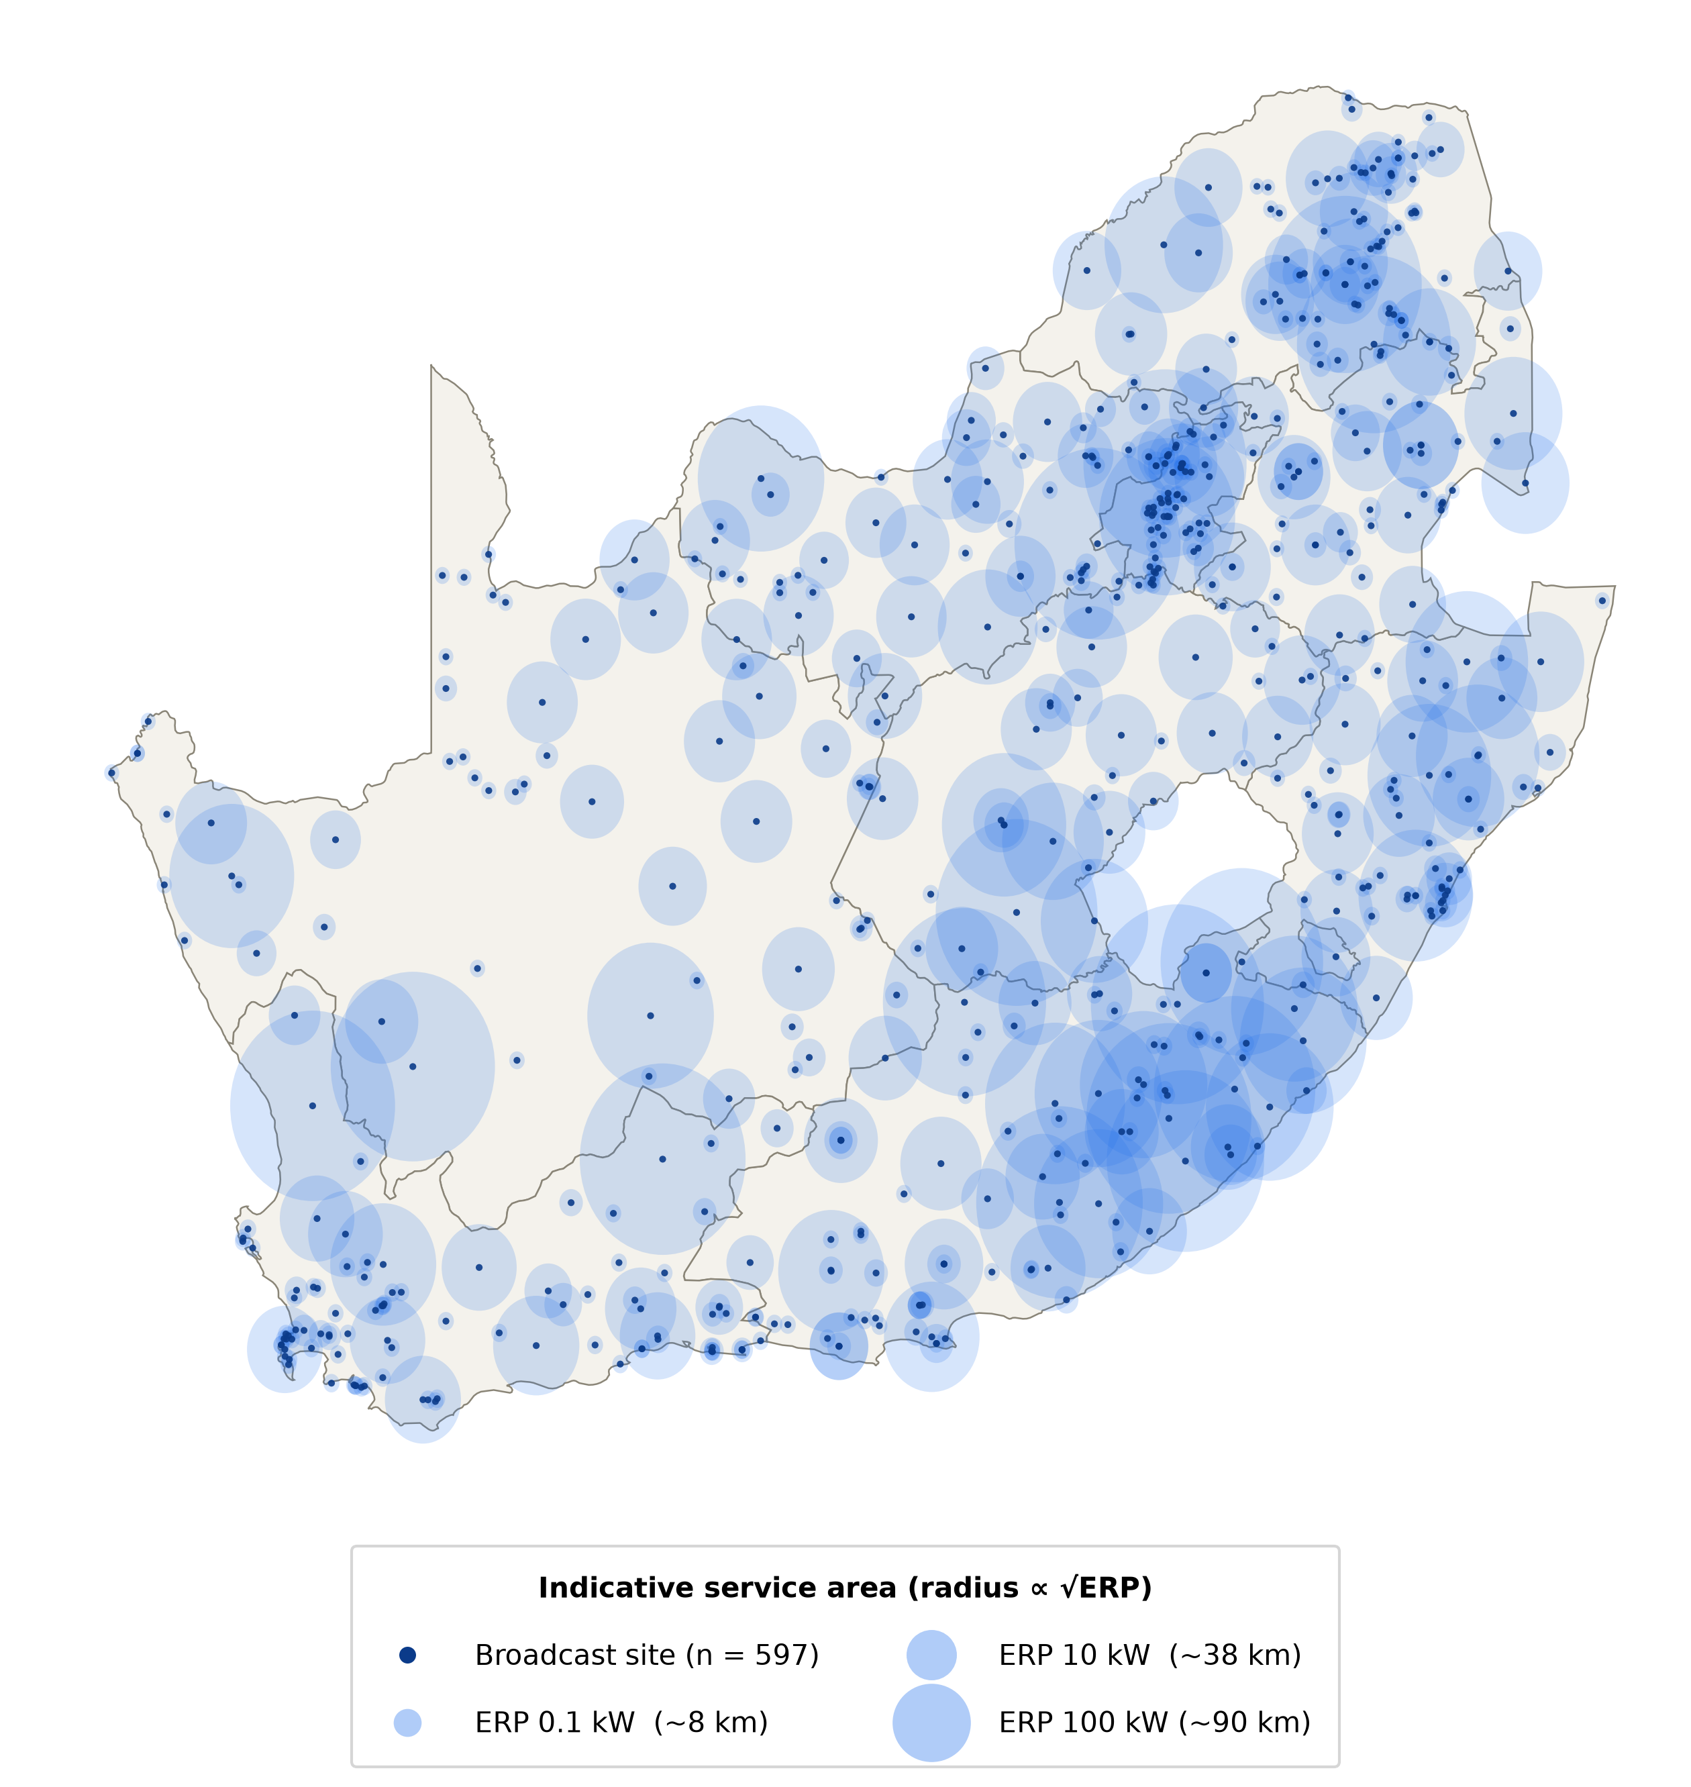
Background & Motivation
Tracking commercial aircraft in the Bistatic Range and Doppler domain using FM PR ?
Using existing FM band illuminators of opportunity
Cost Effective – Air Traffic Control
No Spectrum licensing required
High Doppler resolution
Covert

Slide 3
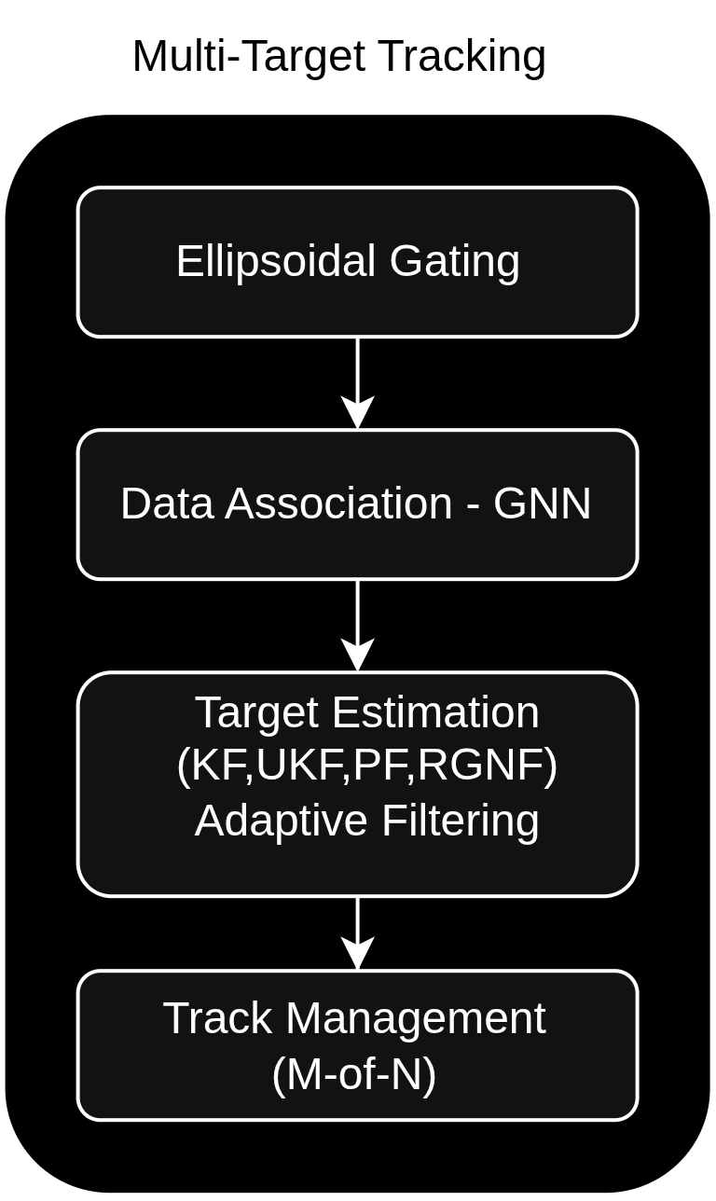
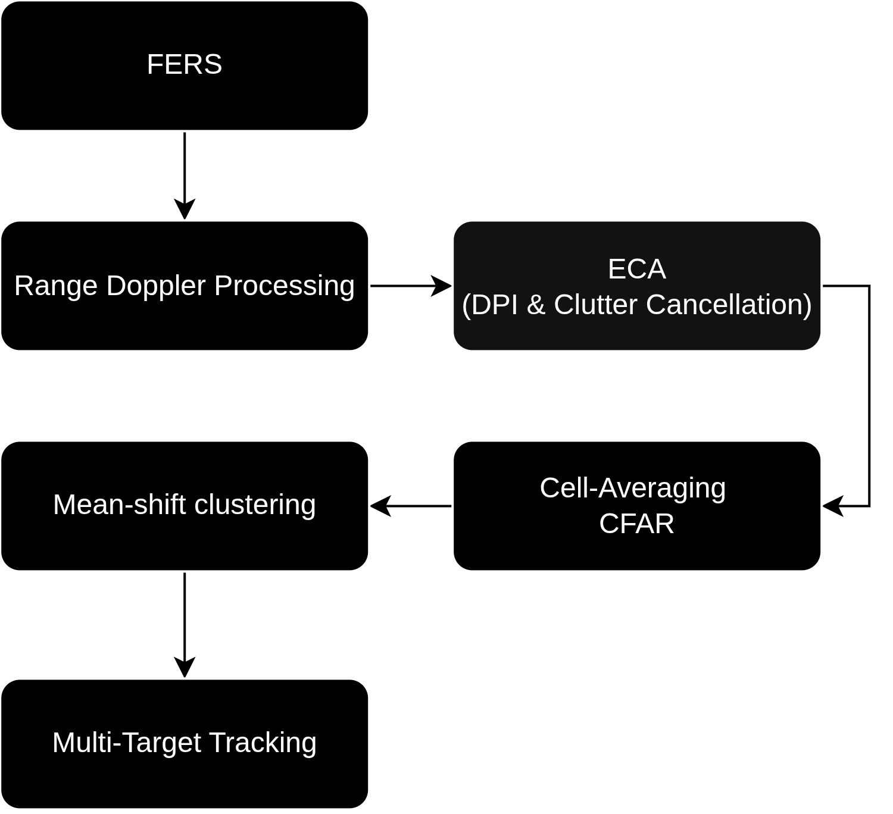
System overview

Slide 4
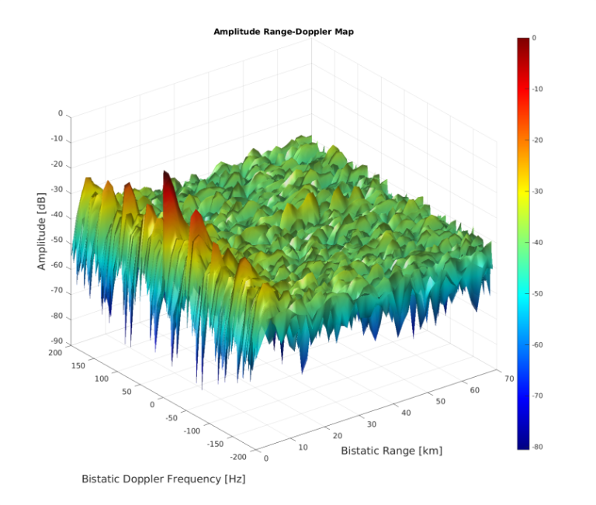
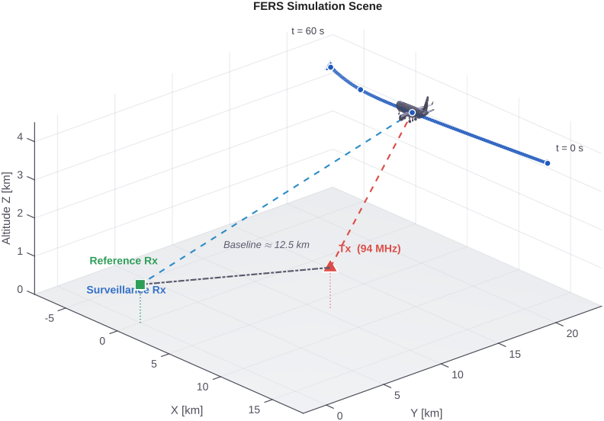
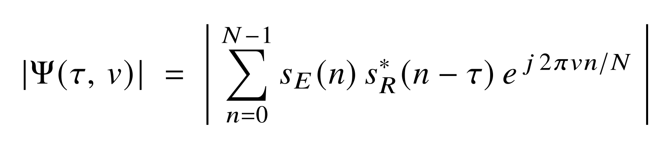
RADAR Processing Chain
FERS –> ARD
<number>

Slide 5
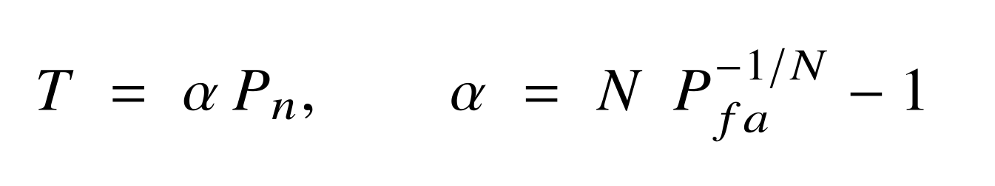
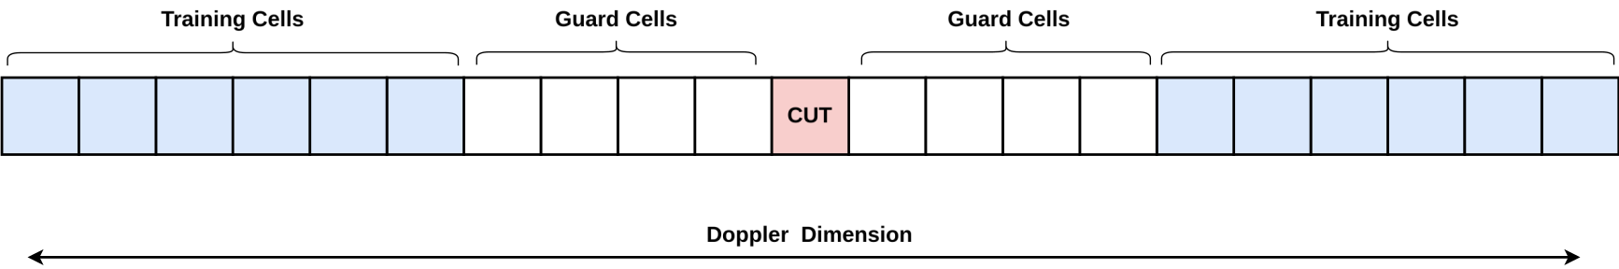
RADAR Processing Chain
<number>

Slide 6
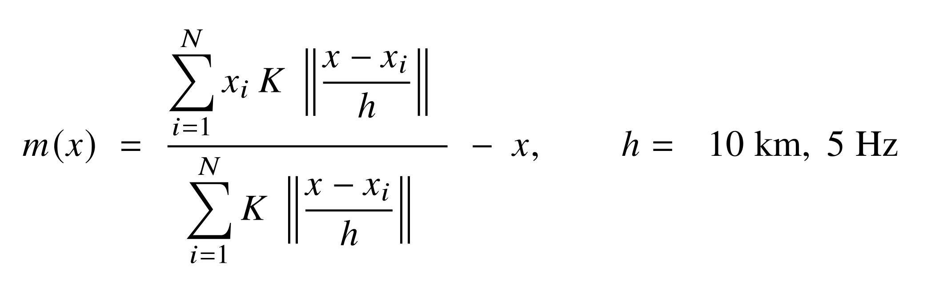
RADAR Processing Chain
Mean-shift Clustering
No Prior on number of Clusters
Bandwidth in physical units
Non-parametric
Alternatives (K-means, DBSCAN, Gaussian Mixture)

Slide 7
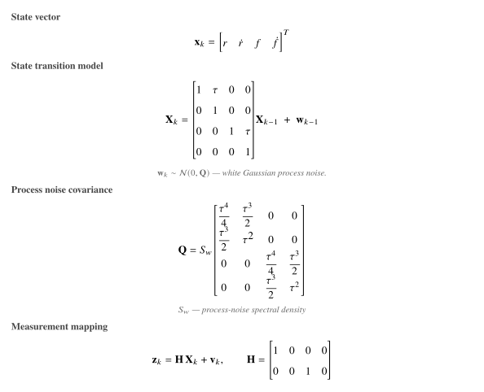
Tracking Filters
Kalman Filter
Unscented Kalman Filter
Recursive Gauss Newton Filter
Particle Filter

Slide 8
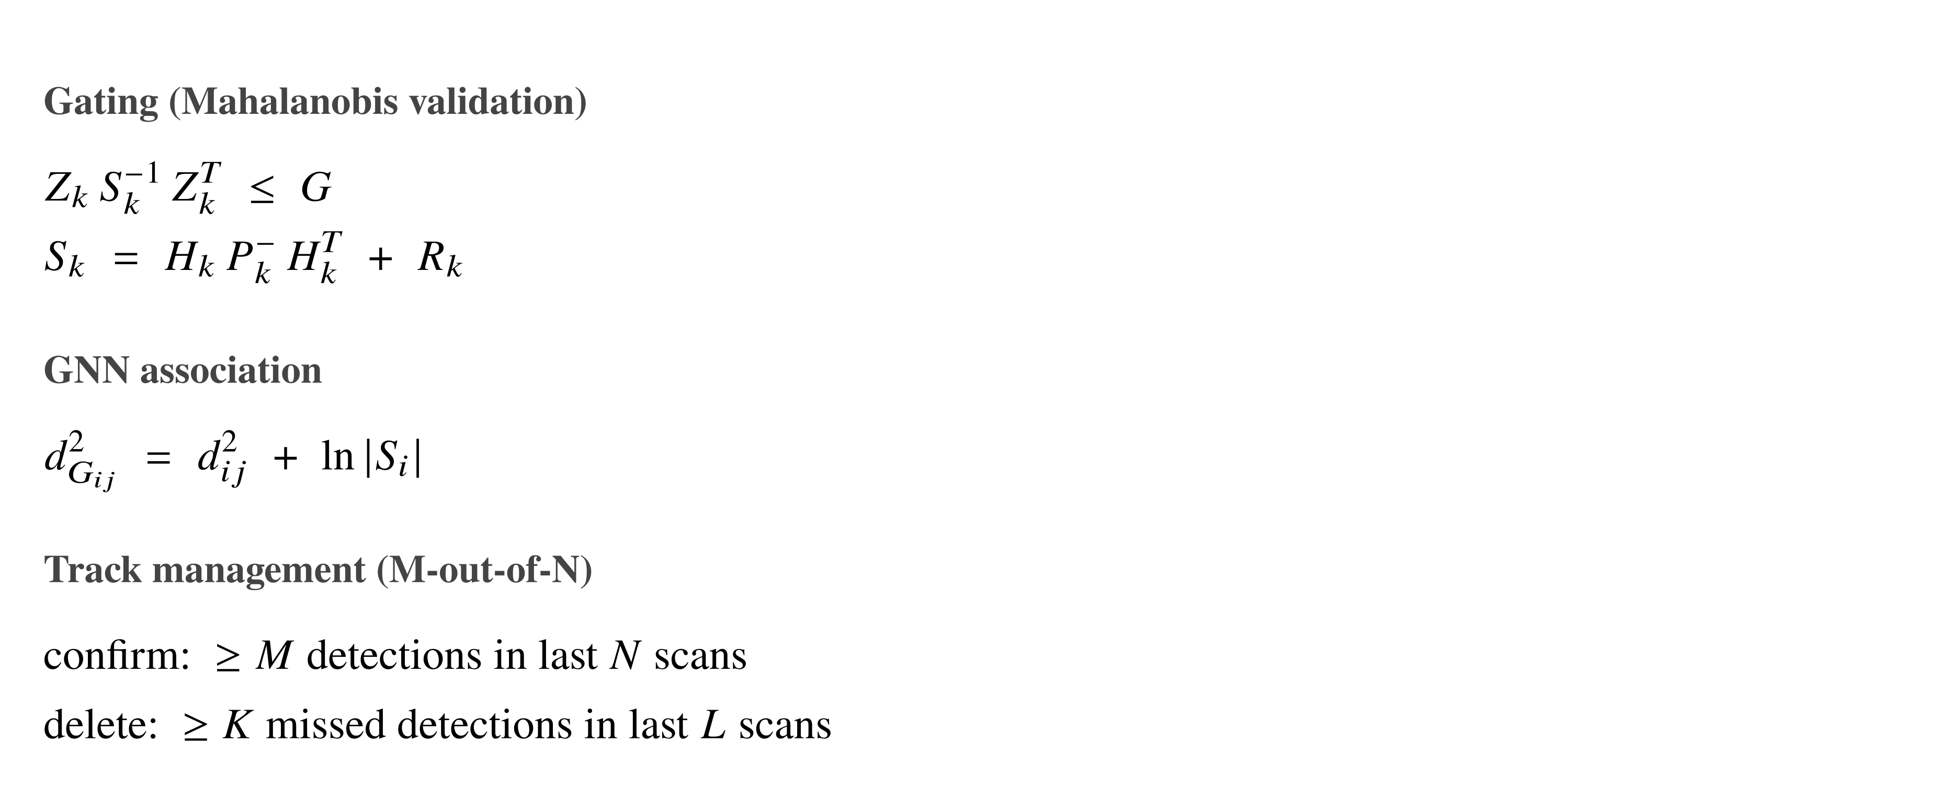
MuLti-Target Tracking

Slide 9
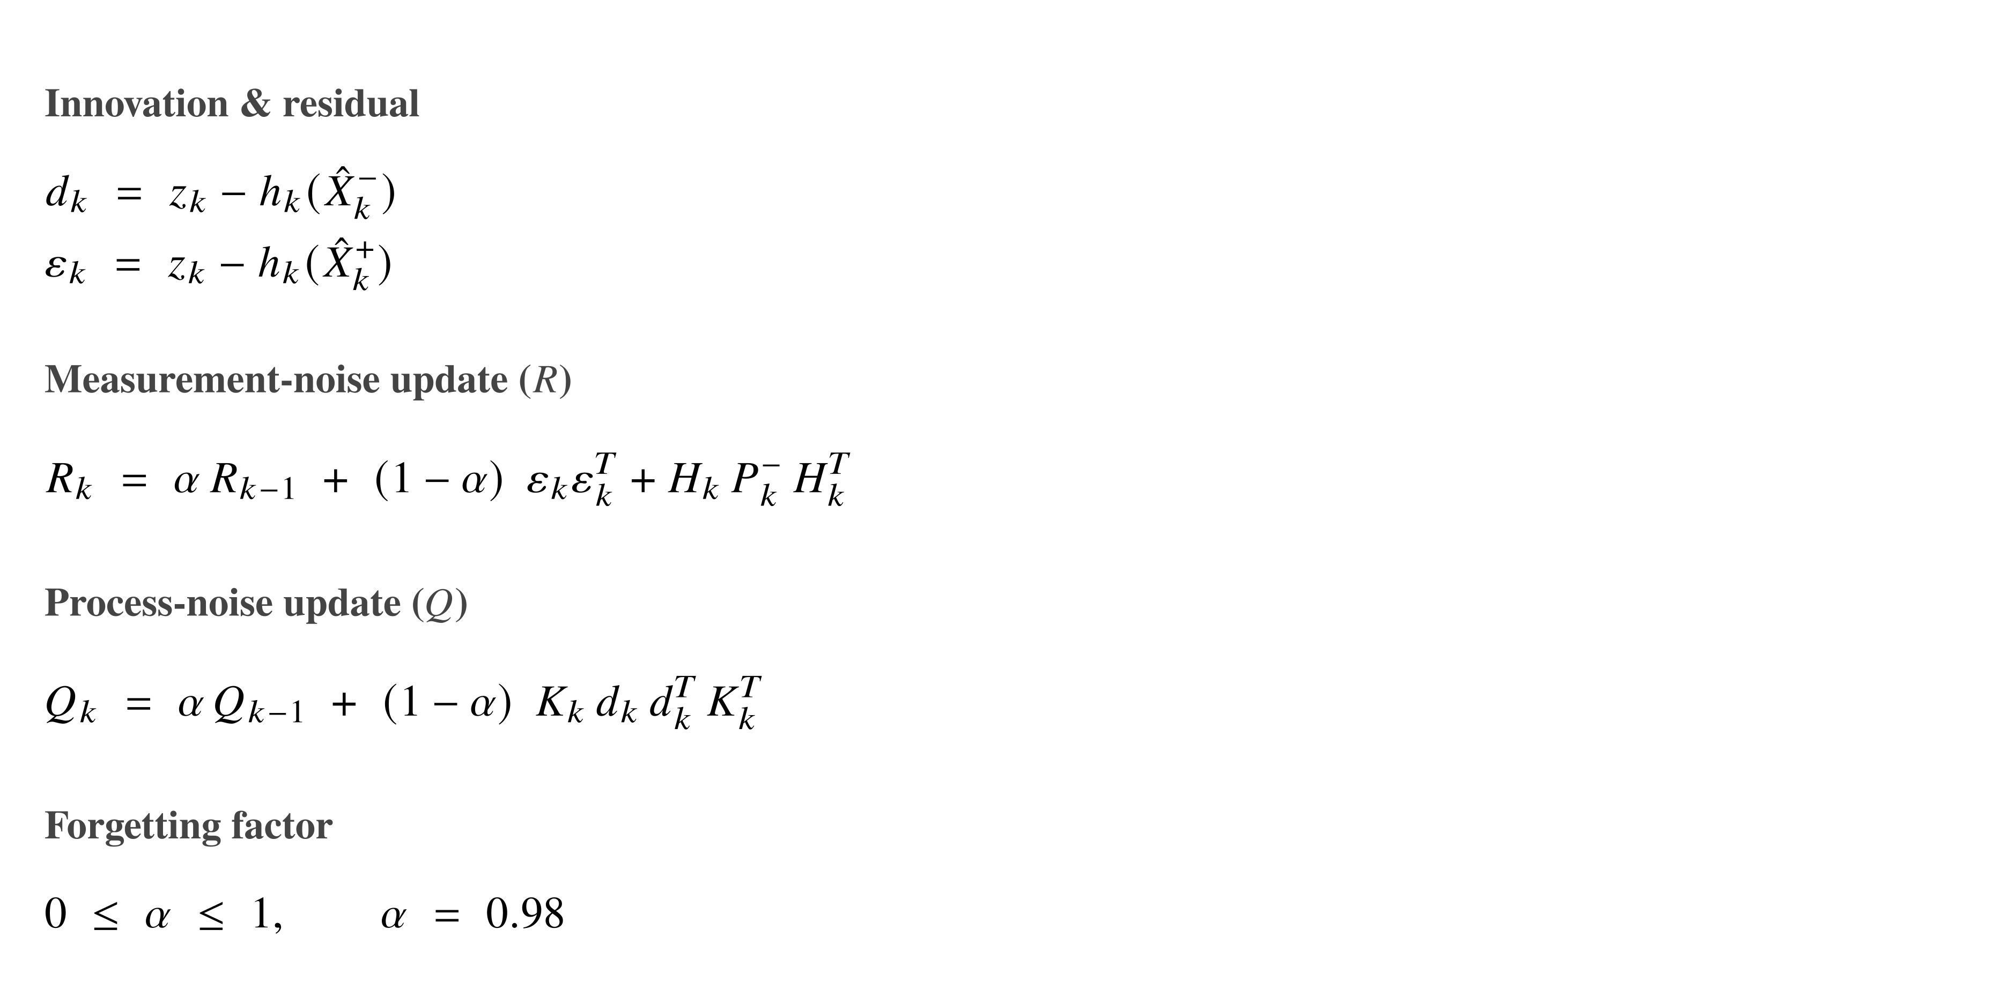
Adaptive Filtering
Fixed Q and R
Outliers

Slide 10
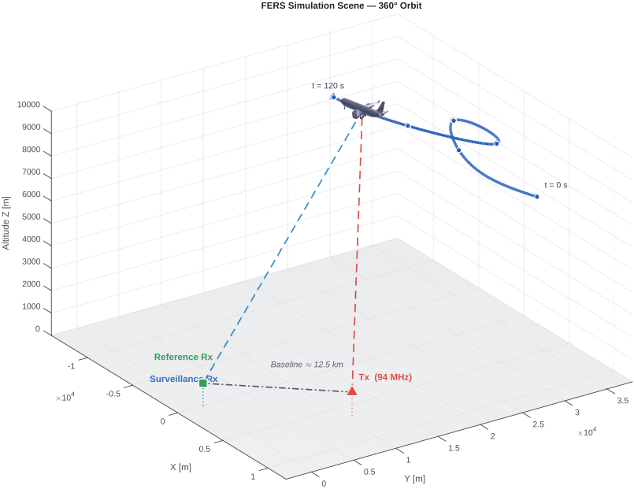
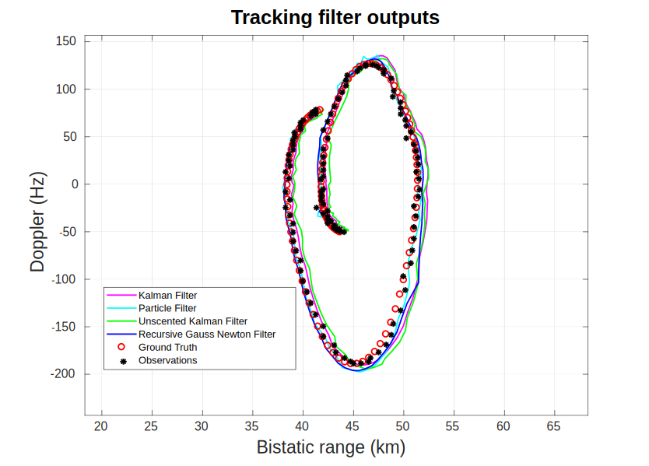
Performance Evaluation

Slide 11
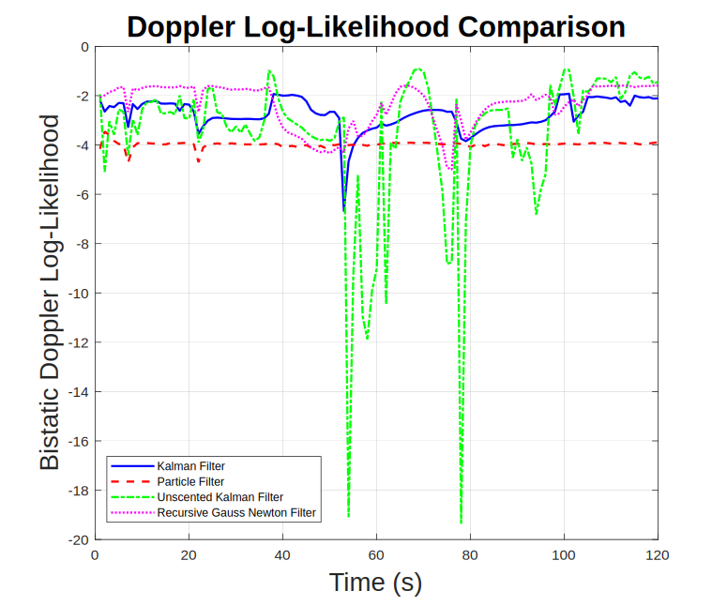
Log-Likelihood

Slide 12
NEES
<number>

Slide 13
Computation Load

Slide 14
Recommendations & Future Work
<number>

Slide 15
References
-Independent Communications Authority of South Africa (ICASA), Discussion Document on the Optimisation of the Frequency Modulation Sound Broadcasting — Tables, Government Gazette No. 46152, April 2022. Available: https://www.icasa.org.za/uploads/files/Discussion-Document-on-the-optimisation-of-the-frequency-modulation-sound -broadcastin_Tables-05042022.docx
<number>

